Slide 1
MS SQL Server Introduction

Slide 2
What is SQL?
SQL stands for Structured Query Language
SQL lets you access and manipulate databases
SQL became a standard of the American National Standards Institute (ANSI) in 1986, and of the International Organization for Standardization (ISO) in 1987
SQL Server
SQL SERVER is a relational database management system (RDBMS) developed by Microsoft. It is primarily designed and developed to compere with MySQL and Oracle database.
SQL Server supports ANSI SQL, which is the standard SQL (Structured Query Language) language. However, SQL Server comes with its own implementation of the SQL language, T-SQL.
T-SQL
T-SQL is a Microsoft propriety Language known as Transact-SQL. It provides further capabilities of declaring variable, exception handling, stored procedure, etc.
SSMS
SQL Server Management Studio (SSMS) is the main interface tool for SQL Server, and it supports both 32-bit and 64-bit environments.

Slide 3
Version History SQL Server
Microsoft and Sybase released version 1.0 in 1989.
However, the partnership between these two ended in the early 1990s.
Microsoft maintained ownership rights to the name SQL Server.
Since the 1990s, subsequent versions of SQL Server have been released including SQL Server 2000, 2005, 2008, 2012, 2014, 2016, 2017, and 2019
SQL Server Editions
Following editions are available
SQL Server Enterprise: It is used in the high end, large scale and mission Critical business. It provides High-end security, Advanced Analytics, Machine Learning, etc.
SQL Server Standard: It is suitable for Mid-Tier Application and Data marts. It includes basic reporting and analytics.
SQL Server WEB: It is designed for a low total-cost-of-ownership option for Web hosters. It provides scalability, affordability, and manageability capabilities for small to large scale Web properties.
SQL Server Developer: It is similar to an enterprise edition for the non-production environment. It is mainly used for build, test, and demo.
SQL Server Express: It is for small scale applications and free to use.

Slide 4

MS SQL Server as Client-Server Architecture
Let's have a look at the below early morning conversation between Mom and her Son, Tom.
Ask your brain….!!! "Can you map, who is CLIENT and who the SERVER is?"
The most certain reply would be - "I am pretty smart in that and…. Son is a CLIENT as he is requesting for a cup of coffee and Mother, who is CAPABLE of preparing coffee, is a SERVER."
Here, Tom is requesting his mother, a cup of coffee. Finally, mom does some processing with Milk, coffee, sugar and prepare coffee to serve it hot.
A CLIENT is an application that sends requests to the MS SQL SERVER installed on a given machine. The SERVER is capable of processing input data as requested. Finally, respond with PROCESSED OUTPUT DATA as a result.

Slide 5
Key Components and Services of SQL Server
Database Engine: This component handle storage, Rapid transaction Processing, and Securing Data.
SQL Server: This service starts, stops, pauses, and continues an instance of Microsoft SQL Server. Executable name is sqlservr.exe.
SQL Server Agent: It performs the role of Task Scheduler. It can be triggered by any event or as per demand. Executable name is sqlagent.exe.
SQL Server Browser: This listens to the incoming request and connects to the desired SQL server instance. Executable name is sqlbrowser.exe.
SQL Server Full-Text Search: This lets user running full-text queries against Character data in SQL Tables. Executable name is fdlauncher.exe.
SQL Server VSS Writer: This allows backup and restoration of data files when the SQL server is not running. Executable name is sqlwriter.exe.
SQL Server Analysis Services (SSAS): Provide Data analysis, Data mining and Machine Learning capabilities. SQL server is integrated with R and Python language for advanced analytics. Executable name is msmdsrv.exe.
SQL Server Reporting Services (SSRS): Provides reporting features and decision-making capabilities. Executable name is ReportingServicesService.exe
SQL Server Integration Services (SSIS): Provided Extract-Transform and Load capabilities of the different type of data from one source to another. It can be view as converting raw information into useful information. Executable name is MsDtsSrvr.exe

Slide 6
SQL Server Instances
SQL Server allows you to run multiple services at a go, with each service having separate logins, ports, databases, etc. These are divided into two-
Primary instances
Named instances.
There are two ways through which we may access the primary instance. First, we can use the server name. Secondly, we can use its IP address. Named instances are accessed by appending a backslash and instance name.
For example, to connect to an instance named xyx on the local server, you should use 127.0.0.1\xyz. From SQL Server 2005 and above, you are allowed to run up to 50 instances simultaneously on a server.
Note that even though you can have multiple instances on the same server, only one of them must be the default instance while the rest must be named instances. One can run all the instances concurrently, and each instance runs independent of the other instances.

Slide 7
Importance of SQL Server Instances
The following are the advantages of SQL Server instances-
For installation of different versions on one machine
You can have different versions of SQL Server on a single machine. Each installation works independently from the other installations.
For cost reduction
Instances can help us reduce the costs of operating SQL Server, especially in purchasing the SQL Server license. You can get different services from different instances, hence no need for purchasing one license for all services.
For maintenance of development, production and test environments separately
This is the main benefit of having many SQL Server instances on a single machine. You can use different instances for development, production and test purposes.
For reducing temporary database problems
When you have all services running on a single SQL Server instance, there are high chances of having problems, especially problems that keep on recurring. When such services are run on different instances, you can avoid having such problems.
For separating security privileges
When different services are running on different SQL Server instances, you can focus on securing the instance running the most sensitive service.
For maintaining a standby server

Slide 8
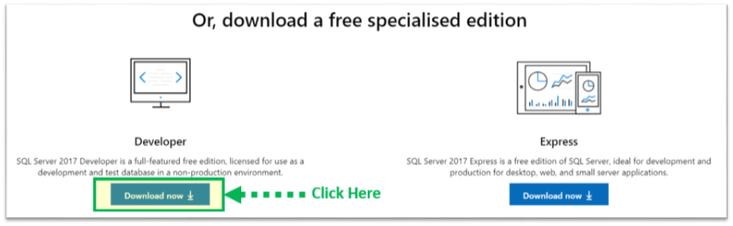
Download and Installation
Pre-Requisites
.Net Framework
1GB of recommended memory
NTFS system.
Download & Install
Go to URL: https://www.microsoft.com/en-in/sql-server/sql-server-downloads
MS SQL 2017
https://download.microsoft.com/download/5/A/7/5A7065A2-C81C-4A31-9972-8A31AC9388C1/SQLServer2017-SSEI-Dev.exe
Microsoft provides two specialized free editions to work on MS SQL server-
Developer – It has all feature which MS SQL server offers but we cannot use it in production. From the learning perspective, is it an ideal candidate to start.
Express: This is also a free version but with the limited set of features with no business intelligence applications.
We will select the Developer edition for installation.
Click on "Download now“

Slide 9
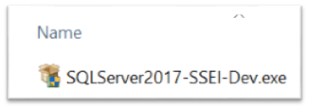
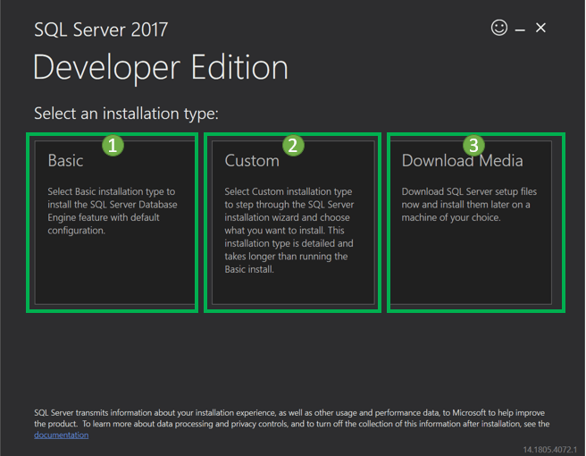
We will get set up as 'SQLServer2017-SSEI-Dev.exe'.
Double click on "SQLServer2017-SSEI-Dev.exe". Below screen will appear with three options- Basic, Custom and Download files.

Slide 10
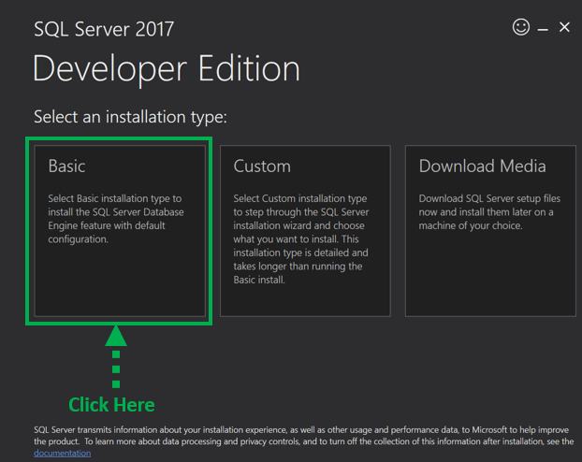
Choose the basic version by clicking on the 'Basic' option, as it has all default configuration required to learn MS SQL.

Slide 11
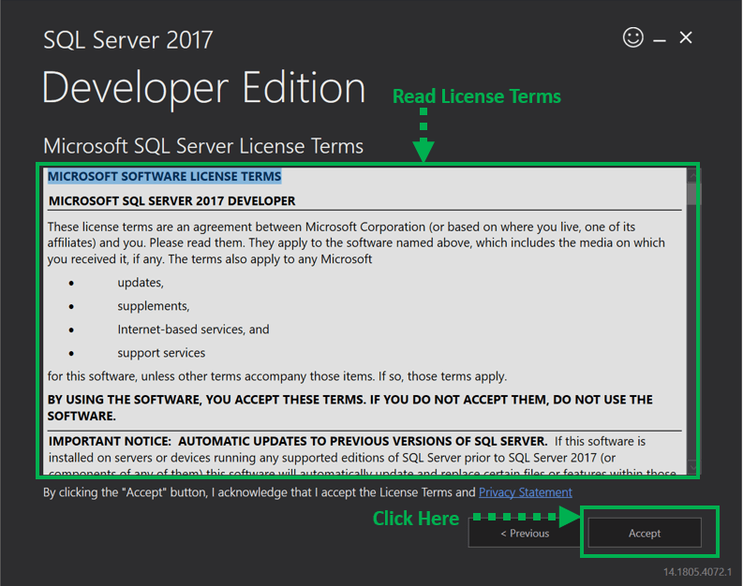
'Microsoft Server License Terms' screen will appear. Read the License Terms and then click 'Accept.'

Slide 12
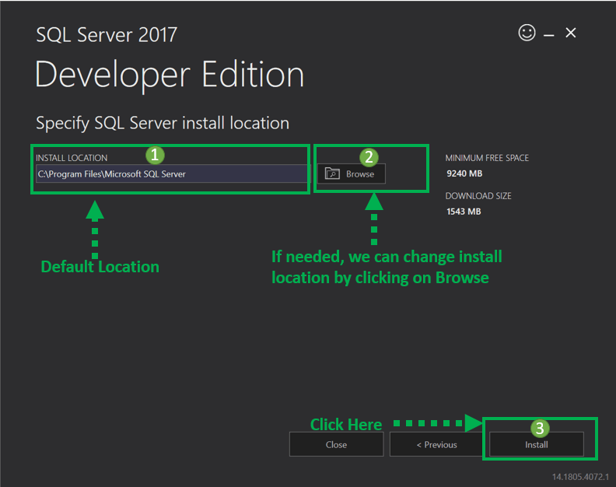
Below 'SQL server install location' window will appear.
The Default location is C:\Program Files\Microsoft SQL Server.
Optionally, we can also change the installation location by clicking on Browse.
Once the location is selected, click the 'Install' button.

Slide 13
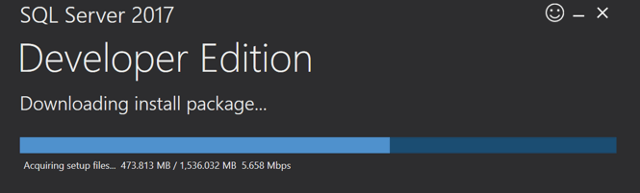
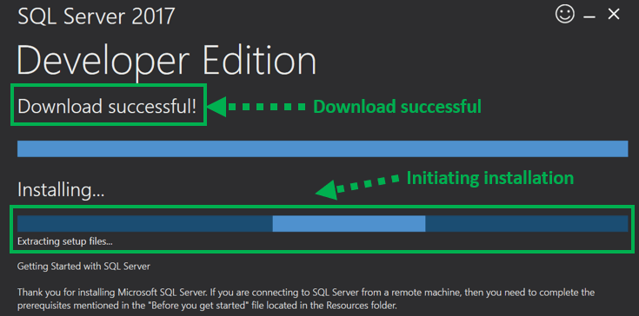
Below 'Downloading install package' progress screen will be displayed. Wait until the download is complete.
Once, the download is complete; the system will initiate installing developer edition.

Slide 14
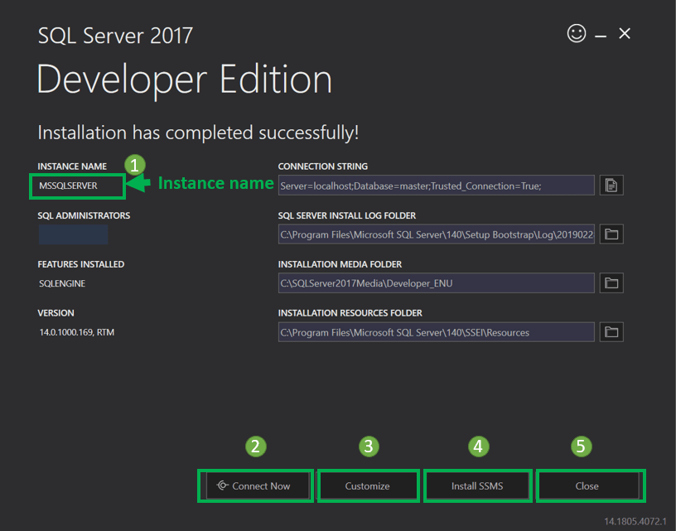
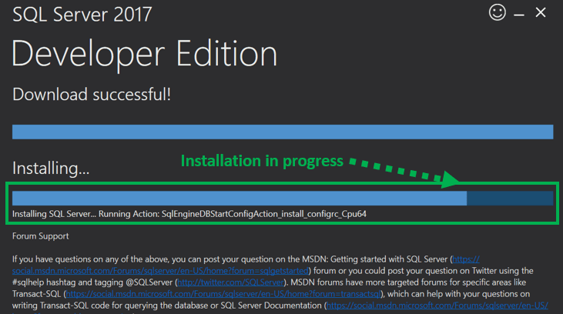
Below screen show installation progress.
Below screen show installation progress.

Slide 15
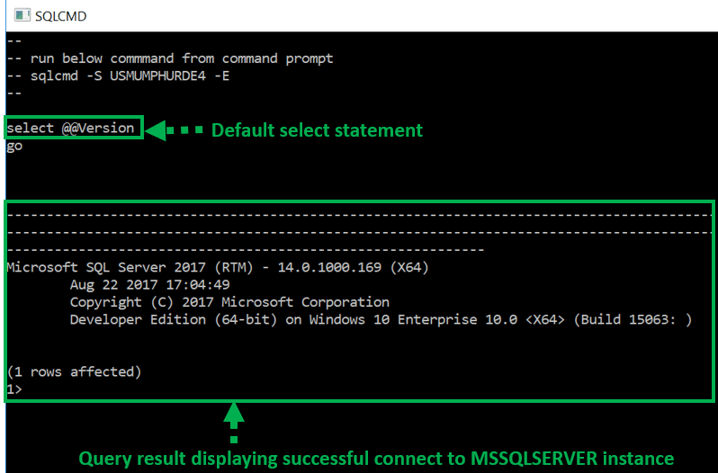
This setup is self-sufficient for proceeding further with learning SQL server, and we can 'Close' this window.
However, below is a summary of the label and button:
Instance name: This is by default labeled as MSSQLSERVER.
Connect now: This will open a separate command line window for connection testing of what we have just installed. The system will run by default 'select @@Version' statement to confirm that we can connect to new MSSQLSERVER instance successfully.
Customize: This will open the SQL Installation
center to customize further and add feature other
than which are there as a part of the BASIC installation.
Install SSMS: This is IDE which will take us to
Microsoft SSMS download link.
Close: This will close this window. The user is now
ready to install SSMS IDE as instructed in SSMS
tutorial.

Slide 16
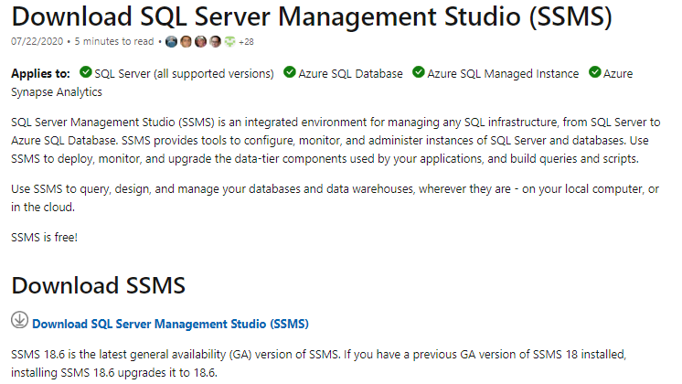
SQL Server Management Studio (SSMS)
SSMS is an IDE that provides a graphical interface for connecting and working with MS SQL server. It was launched with Microsoft SQL Server 2005 and is used for configuring, managing, and administering all components within Microsoft SQL Server.
Download and Install SQL Server Management Studio
Go to this link and click on Download SQL Server Management Studio 18.0 (preview 6)
https://docs.microsoft.com/en-us/sql/ssms/download-sql-server-management-studio-ssms?view=sql-server-2017

Slide 17
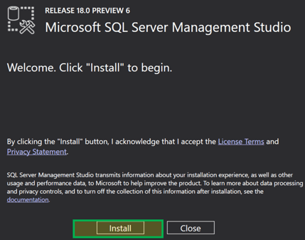
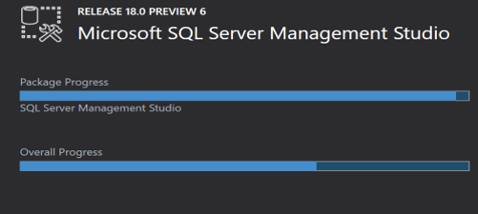
Once downloaded we will get a .exe file named as "SSMS-Setup-ENU.exe." Double click on it.
Below window will appear. Click on 'Install.'
Installation will begin. Below screen will show Packages progress and Overall Progress.

Slide 18
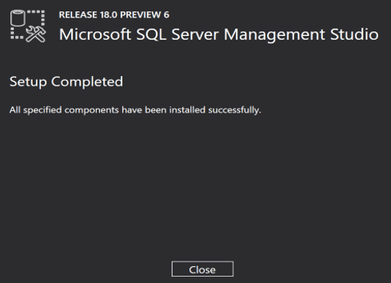
Once Completed, Setup will show the below screen with "Setup Completed" message.
How to access "Management Studio."
Now, we're ready to open "Management Studio. Go To Start Menu>Programs>Microsoft SQL Server Tools 18> Microsoft SQL Server Management Studio 18.
Below 'Connect to Server' screen will appear. Server Name defaults to the name selected while installing MS SQL server.

Slide 19
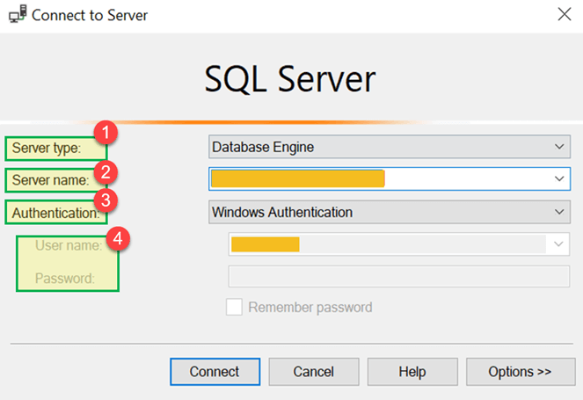
Let's understand each of the above fields
Server type: This is an option to select one out of four available MS SQL services option. We will be working on 'Database Engine' for creating and working with Database. Other Server type includes Analysis, Reporting & Integration Services.

Slide 20
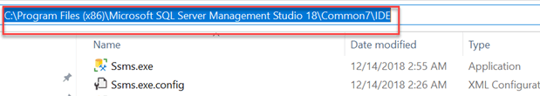
Server name: This is Server's name where MS SQL Server is installed and need to establish the connection with that server. Generally, we use the server name as "Machine name\Instance." Here Instance is the name given to SQL Server instance while SQL server installation.
Authentication: This is defaulted to "Windows Authentication" if we use "Windows Authentication" during SQL Server Installation. Else, if we select 'Mixed Mode (Windows Authentication & SQL Server Installation)' then Authentication will be defaulted to "SQL Server Installation."
User name\Password: If Authentication is selected other than "Windows Authentication" like "SQL server Installation" then these two fields will be required.
Click on 'Connect.' Now you will be connected to 'Data Management Studio.'
Access "Management studio" using Command line
Alternatively, we can also open SQL Server Management Studio using Window Command line. You need to have full path of ssms.exe. Below is default location and file name-
Path:
C:\Program Files (x86)\Microsoft SQL Server Management Studio 18\Common7\IDE Exe name: ssms.exe

Slide 21

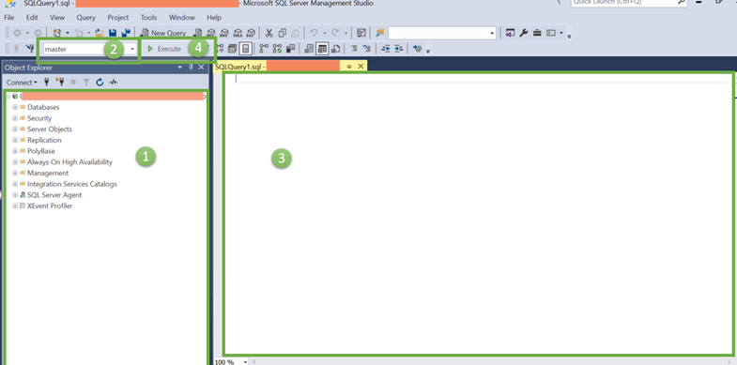
Here, are the steps to access via command line-
Open Command Prompt by typing CMD in Search window.
Type entire path followed by ssms.exe as shown below and Press 'Enter'.
'Connect to Server' screen will appear in a similar way as described in the previous section.
Introduction to Data Management Studio IDE
Below is the start screen for Data Management Studio.

Slide 22
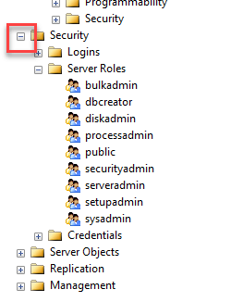
Let's discuss each section in detail-
Object Explorer
The Object Explorer provides a tree view of the database objects contained in the server. This section shows all the Databases, Security, Server Object for quick reference. To view the components of each object, just click the + icon located to the left of the object which will expand it.
Databases Selection Dropdown
This dropdown allows the user to select the Database in which we will be running our queries.

Slide 23
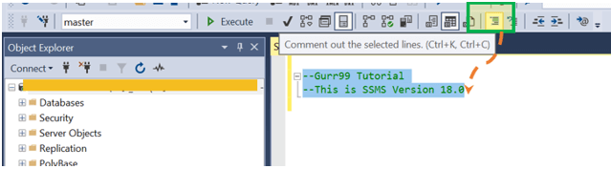
Query Editor
Here we can write all our queries. MS SQL server provides interactive suggestions for tables,
columns, etc. for easy queries creations and much more.
Execute button
This button will finally execute the query and return the results.
SSMS Tips and Issues
Management Studio is a standalone product. It does not correspond to any specific version of SQL Server. For example, we can use SMMS Version 18 with SQL Server 2017, SQL Server 2016 as well.
Large codes reduce readability. Use comments for better Readability. Put "--" in front of any line to comment it out.
Group comment: We can comment out the group of line by selecting them all and clicking on Icon shown in below image.

Slide 24
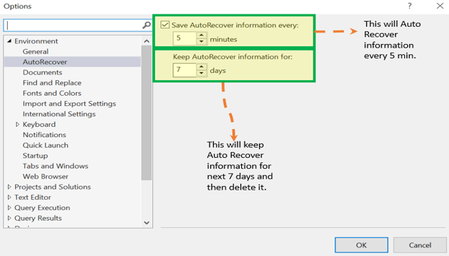
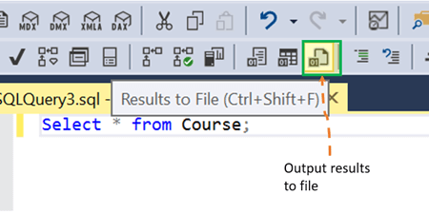
Unexpected shutdown, a system failure can cause unexpected data loss. Set 'AutoRecover' option checked to minimize data loss. We can even customized time interval to AutoRecover data and the number of days this information to be saved before deleting it. Tools> Options>Environment>AutoRecover.
In case of failure, the popup window will appear with the name
We often need the result of our query to be saved in text format for future references.
We can click and select the above-highlighted icon & run any Query. We will be prompt to specify the location where the file can be saved future reference.

Slide 25
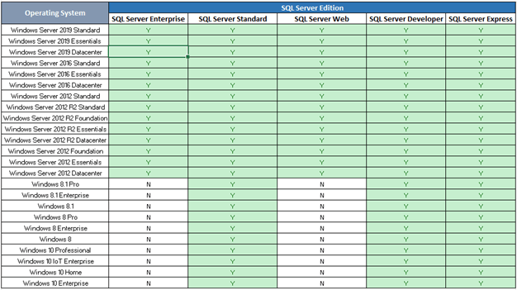
SSMS supported operating systems
Below table shows SQL server edition and its corresponding supported Operating system. 'Y' means Supported and 'N' Means Not Supported.

Slide 26
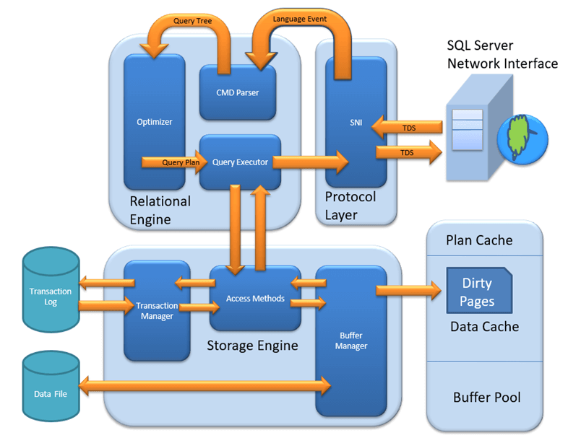
SQL Server Architecture
MS SQL Server is a client-server architecture. MS SQL Server process starts with the client application sending a request. The SQL Server accepts, processes and replies to the request with processed data. Let's discuss in detail the entire architecture shown below-
As the below Diagram depicts there are three major components in SQL Server Architecture-
Protocol Layer
Relational Engine
Storage Engine

Slide 27
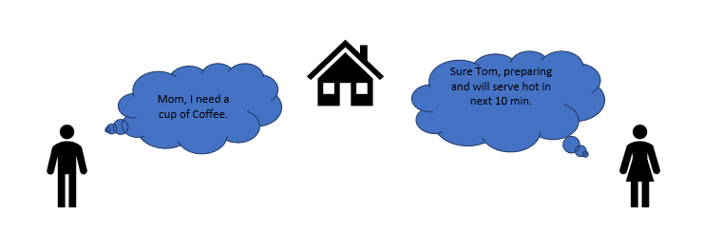
Protocol Layer - SNI
MS SQL SERVER PROTOCOL LAYER supports 3 Type of Client Server Architecture. We will start with "Three Type of Client Server Architecture" which MS SQL Server supports.
Shared Memory
Let's reconsider an early morning Conversation scenario.
MOM and TOM - Here Tom and his Mom, were at the same logical place, i.e. at their home. Tom was able to ask for Coffee and Mom was able it serve it hot.
MS SQL SERVER - Here MS SQL server provides SHARED MEMORY PROTOCOL. Here CLIENT and MS SQL server run on the same machine. Both can communicate via Shared Memory protocol.
Analogy: Lets map entities in the above two scenarios. We can easily map Tom to Client, Mom to SQL server, Home to Machine, and Verbal Communication to Shared Memory Protocol.

Slide 28
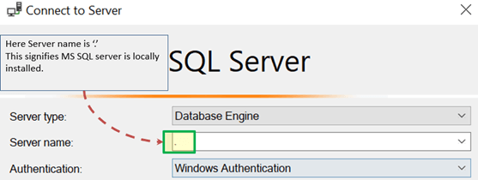
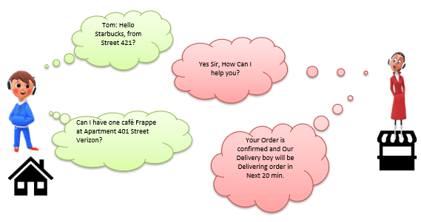
From the desk of configuration and installation-
For Connection to Local DB – In SQL Management Studio, "Server Name" Option could be
"."
"localhost"
"127.0.0.1"
"Machine\Instance“
TCP/IP
Now consider in the evening, Tom is in the party mood. He wants a Coffee ordered from a well-known Coffee Shop. The Coffee shop is located 10 km away from his home.

Slide 29
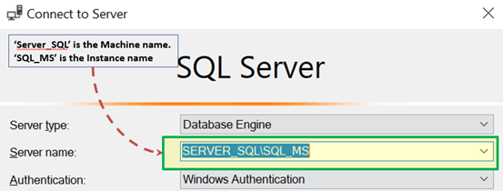
Here Tom and Starbuck are in different physical location. Tom at home and Starbucks at the busy marketplace. They're communicating via Cellular network. Similarly, MS SQL SERVER provides the capability to interact via TCP/IP protocol, where CLIENT and MS SQL Server are remote to each other and installed on a separate machine.
Analogy: Lets map entities in the above two scenarios. We can easily map Tom to Client, Starbuck to SQL server, the Home/Market place to Remote location and finally Cellular network to TCP/IP protocol.
Notes from the desk of Configuration/installation:
In SQL Management Studio - For Connection via TCP\IP, "Server Name" Option has to be "Machine\Instance of the server."
SQL server uses port 1433 in TCP/IP.

Slide 30
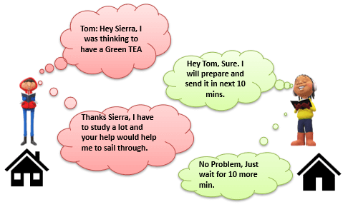
Named Pipes
Now finally at night, Tom wanted to have a light green tea which her neighbor, Sierra prepare very well.
Here Tom and his Neighbor, Sierra, are in same physical location, being each other's neighbor. They're communicating via Intra network. Similarly, MS SQL SERVER provides the capability to interact via the Named Pipe protocol. Here the CLIENT and MS SQL SERVER are in connection via LAN.
Analogy: Lets map entities in the above two scenarios. We can easily map Tom to Client, Sierra to SQL server, Neighbor to LAN and finally Intra network to Named Pipe Protocol.
Notes from the desk of Configuration/installation-
For Connection via Named Pipe: This option is disabled by default and needs to be enabled by the SQL Configuration Manager.

Slide 31
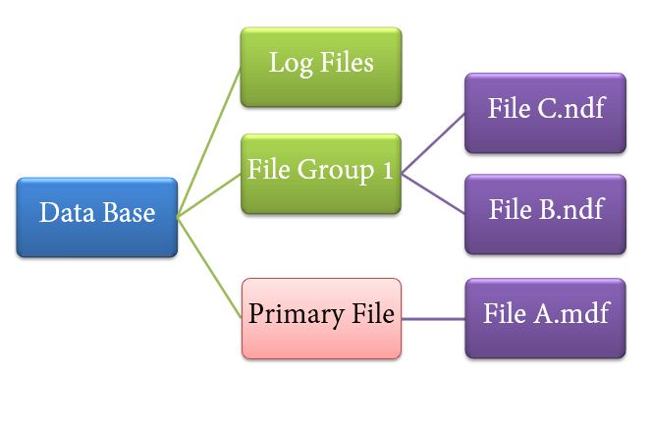
File types
Primary file(.mdf→ Master database file)
Every database contains one Primary file.
This store all important data related to tables, views, Triggers, etc.
Extension is .mdf usually but can be of any extension.
Secondary file(.ndf→ Next database file)
Database may or may not contains multiple Secondary files.
This is optional and contain user-specific data.
Extension is .ndf usually but can be of any extension.
Log file(Log database file)
Also known as Write ahead logs.
Extension is .ldf
Used for Transaction Management.
This is used to recover from any unwanted instances. Perform important task of Rollback to uncommitted transactions.

Slide 32
What is RDBMS?
RDBMS stands for Relational Database Management System. RDBMS is the basis for SQL, and for all modern database systems like MS SQL Server, IBM DB2, Oracle, MySQL, and Microsoft Access.
A Relational database management system (RDBMS) is a database management system (DBMS) that is based on the relational model as introduced by E. F. Codd (Edgar Frank Codd).
What is a table?
The data in an RDBMS is stored in database objects which are called as tables. This table is basically a collection of related data entries and it consists of numerous columns and rows.
Remember, a table is the most common and simplest form of data storage in a relational database. The following program is an example of a CUSTOMERS table −
+----+----------+-----+-----------+----------+
| ID | NAME | AGE | ADDRESS | SALARY |
+----+----------+-----+-----------+----------+
| 1 | Ramesh | 32 | Ahmedabad | 2000.00 |
| 2 | Khilan | 25 | Delhi | 1500.00 |
| 3 | kaushik | 23 | Kota | 2000.00 |
| 4 | Chaitali | 25 | Mumbai | 6500.00 |
| 5 | Hardik | 27 | Bhopal | 8500.00 |
| 6 | Komal | 22 | MP | 4500.00 |
| 7 | Muffy | 24 | Indore | 10000.00 |
+----+----------+-----+-----------+----------+

Slide 33
What is a field?
Every table is broken up into smaller entities called fields. The fields in the CUSTOMERS table consist of
ID, NAME, AGE, ADDRESS and SALARY.
A field is a column in a table that is designed to maintain specific information about every record in the table.
What is a Record or a Row?
A record is also called as a row of data is each individual entry that exists in a table. For example, there are 7 records in the above CUSTOMERS table. Following is a single row of data or record in the CUSTOMERS table −
+----+----------+-----+-----------+----------+
| 1 | Ramesh | 32 | Ahmedabad | 2000.00 |
+----+----------+-----+-----------+----------+
A record is a horizontal entity in a table.
What is a column?
A column is a vertical entity in a table that contains all information associated with a specific field in a table.

Slide 34
For example, a column in the CUSTOMERS table is ADDRESS, which represents location description
and would be as shown below −
+-----------+
| ADDRESS |
+-----------+
| Ahmedabad |
| Delhi |
| Kota |
| Mumbai |
| Bhopal |
| MP |
| Indore |
+----+------+
What is a NULL value?
A NULL value in a table is a value in a field that appears to be blank, which means a field with a NULL value is a field with no value.
It is very important to understand that a NULL value is different than a zero value or a field that contains spaces.
A field with a NULL value is the one that has been left blank during a record creation.

Slide 35
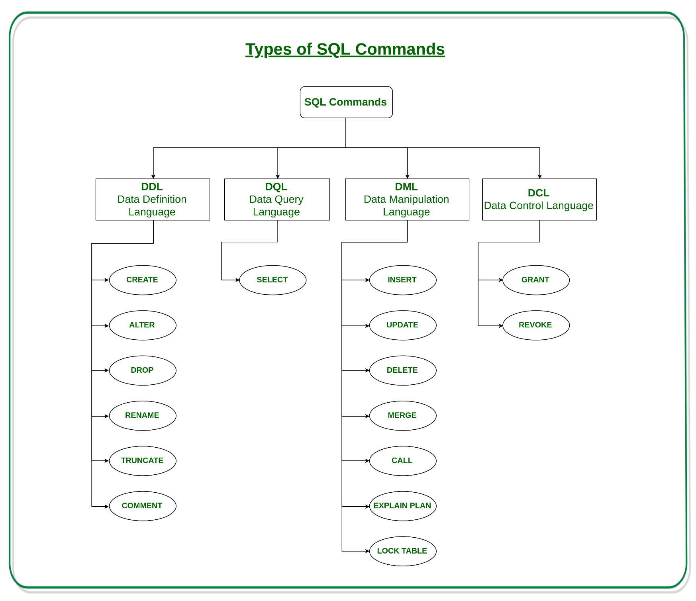
SQL database language
Structured Query Language(SQL) as we all know is the database language by the use of which we can perform certain operations on the existing database and also we can use this language to create a database. SQL uses certain commands like Create, Drop, Insert etc. to carry out the required tasks.
These SQL commands are mainly categorized into four categories as-
DDL – Data Definition Language
DQL – Data Query Language
DML – Data Manipulation Language
DCL – Data Control Language
Though many resources claim there to be another category of SQL clauses TCL – Transaction Control Language. So we will see in detail about TCL as well.

Slide 36
DDL(Data Definition Language) : DDL or Data Definition Language actually consists of the SQL commands that can be used to define the database schema. It simply deals with descriptions of the database schema and is used to create and modify the structure of database objects in the database.
Examples of DDL commands-
CREATE – is used to create the database or its objects (like table, index, function, views, store procedure and triggers).
DROP – is used to delete objects from the database.
ALTER-is used to alter the structure of the database.
TRUNCATE–is used to remove all records from a table, including all spaces allocated for the records are removed.
COMMENT –is used to add comments to the data dictionary.
RENAME –is used to rename an object existing in the database.
DQL (Data Query Language) : DML statements are used for performing queries on the data within schema objects. The purpose of DQL Command is to get some schema relation based on the query passed to it.
Example of DQL:
SELECT – is used to retrieve data from the a database.

Slide 37
DML(Data Manipulation Language) : The SQL commands that deals with the manipulation of data present in the database belong to DML or Data Manipulation Language and this includes most of the SQL statements.
Examples of DML-
INSERT – is used to insert data into a table.
UPDATE – is used to update existing data within a table.
DELETE – is used to delete records from a database table.
DCL(Data Control Language) : DCL includes commands such as GRANT and REVOKE which mainly deals with the rights, permissions and other controls of the database system.
Examples of DCL commands-
GRANT- gives user’s access privileges to database.
REVOKE-withdraw user’s access privileges given by using the GRANT command.
TCL(transaction Control Language) : TCL commands deals with the transaction within the database.
Examples of TCL commands-
COMMIT– commits a Transaction.
ROLLBACK– rollbacks a transaction in case of any error occurs.
SAVEPOINT–sets a save point within a transaction.
SET TRANSACTION–specify characteristics for the transaction.

Slide 38
What is Datatype?
A datatype is defined as the type of data which any column or variable can store in MS SQL Server.
While creating any table or variable, in addition to specifying the name, you also set the Type of Data it will store.
How to use MS SQL datatype
You need to define in advance, the type of data a column or variable can store. Determining data type also restricts the user from entering any unexpected or invalid data.
You can make efficient use of memory by assigning an appropriate data type to variable or column which will allocate only the required amount of system memory for the respective column's data.
MS SQL offers a broad category of the datatype as per user's needs. Like Date, binary images, etc.
Why use Data Types?
Let's, take a sample of simple Sign up page of website application. Three input fields are First Name, Last Name & Contact number.
Here we should note that in real time:
"First/Last Name" will always be alphabetic.
"Contact" will always be numeric.
From the above picture it worth defining "First/Last Name" as a character and "Contact" as an integer.

Slide 39
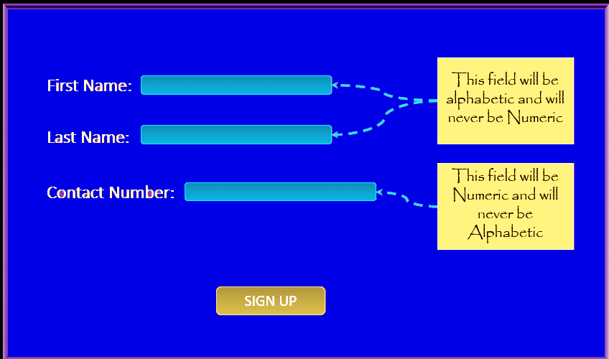
It is evident that in any application, all fields have one or the other type of data. E.g., numeric, alphabetic, date, and many more.
Also, note that different datatype has different memory requirement. Therefore, it makes more sense to define the column or variable with the data type it will hold for efficient use of memory.

